Slide 1
Number theory
Euclidian and Extended Euclidian Algorithm

Slide 2
Divisors
Let a, b and c be integers such that
a = b ·c .
Then b and c are said to divide (or are factors) of a, while a is said to be a multiple of b (as well as of c). The pipe symbol “|” denotes “divides” so the situation is summarized by:
b | a ∧ c | a .

Slide 3
Divisors Examples
Q: Which of the following is true?
77 | 7
7 | 77
24 | 24
0 | 24
24 | 0

Slide 4
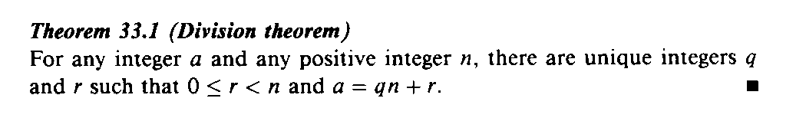
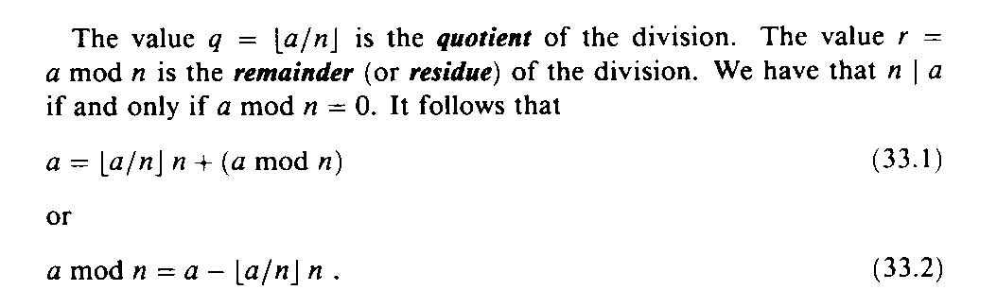
Division & Remainders
31.1

Slide 5
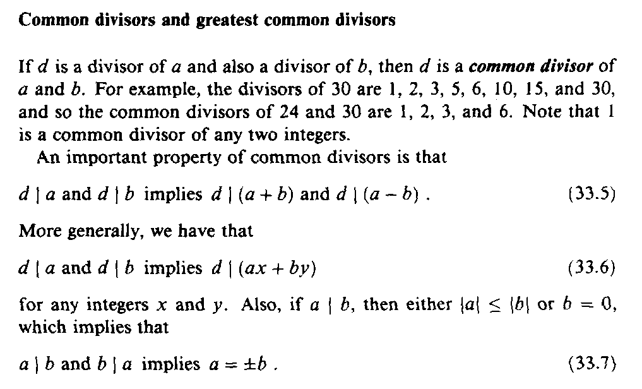
Common Divisors

Slide 6
Greatest Common Divisor Relatively Prime
Let a,b be integers, not both zero. The greatest common divisor of a and b (or gcd(a,b) ) is the biggest number d which divides both a and b.
a and b are said to be relatively prime if gcd(a,b) = 1, so no prime common divisors.

Slide 7
Greatest Common Divisor Relatively Prime
Q: Find the following gcd’s:
gcd(11,77)
gcd(33,77)
gcd(24,36)
gcd(24,25)

Slide 8
Greatest Common Divisor Relatively Prime
A:
gcd(11,77) = 11
gcd(33,77) = 11
gcd(24,36) = 12
gcd(24,25) = 1. Therefore 24 and 25 are relatively prime.
NOTE: A prime number are relatively prime to all other numbers which it doesn’t divide.

Slide 9
Greatest Common Divisor Relatively Prime
EG: More realistic. Find gcd(98,420).
Find prime decomposition of each number and find all the common factors:
98 = 2·49 = 2·7·7
420 = 2·210 = 2·2·105 = 2·2·3·35
= 2·2·3·5·7
Underline common factors: 2·7·7, 2·2·3·5·7
Therefore, gcd(98,420) = 14

Slide 10
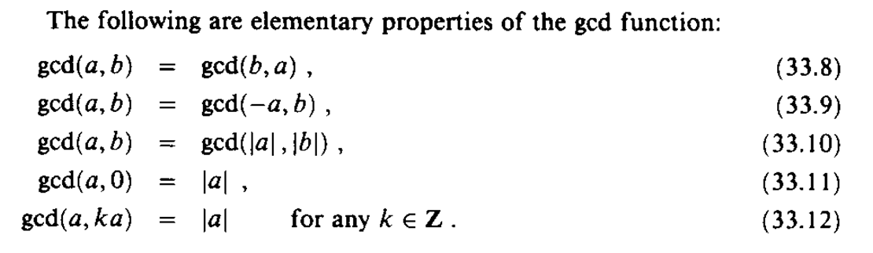
Greatest Common Divisor

Slide 11
Continued
Example
Find the greatest common divisor of 2740 and 1760.
Solution
We have gcd (2740, 1760) = 20.

Slide 12
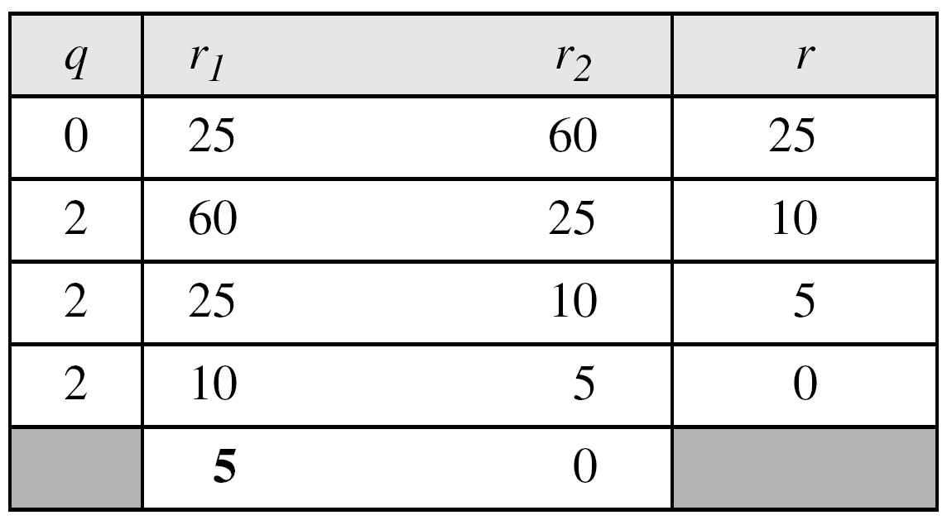
Continued
Example
Find the greatest common divisor of 25 and 60.
Solution
We have gcd (25, 65) = 5.

Slide 13
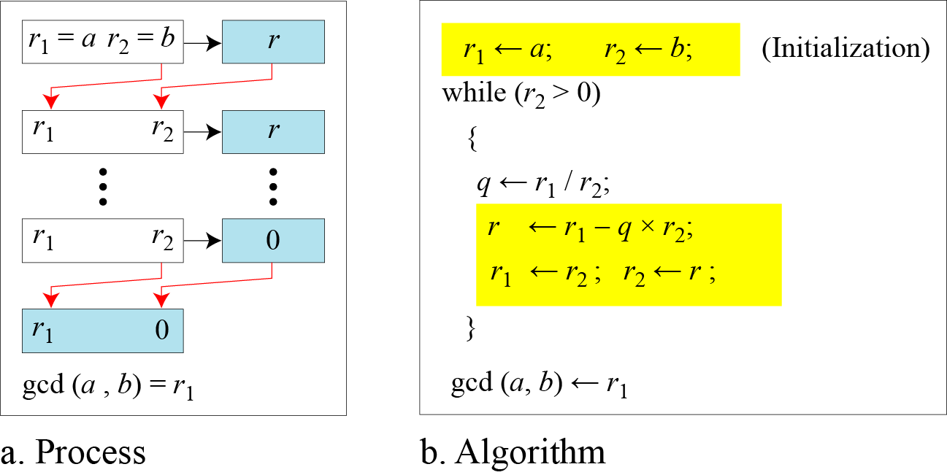

Euclidean Algorithm
Note
When gcd (a, b) = 1, we say that a and b are relatively prime.

Slide 14
The GCD and Linear Combinations
Theorem 31.2: If a and b are integers not both 0, then gcd(a, b) is the smallest positive element of the set {ax + by : x, y are integers} of linear combinations of a and b. Proof: see text p. 853.

Slide 15
The GCD and Linear Combinations (2)
Corollaries:
For any integers a and b, if d|a and d|b then d|gcd(a, b).
For all integers a and b and any nonegative integer n, gcd(an, bn) = n gcd(a, b).
For all positive integers n, a, and b, if n|ab and gcd(a, n) = 1, then n|b.

Slide 16
Relatively Prime Integers
Two integers a and b are relatively prime if and only if their only common divisor is 1 (i.e., gcd(a, b) = 1).
Theorem 31.6: For any integers a, b, and p, if both gcd(a, p) = 1 and gcd(b, p) = 1, then gcd(ab, p) = 1. Proof: p. 854 in text.

Slide 17
Divisibility by Primes
Theorem 31.7: For all primes p and all integers a, b, if p|ab, then p|a or p|b (or both). Proof: p. 854 in text

Slide 18
The Unique Factorization Theorem
Theorem 31.8 (Unique Factorization): A composite number a can be written in exactly one way as a product of the form
where the p_{i} are prime, p₁ < p₂ < …< p_{r}, and the e_{i} are positive integers. Proof: Exercise 31.1-10 in text

Slide 19
The GCD Recursion Theorem
Theorem 31.9 (GCD recursion theorem): For any nonnegative integer a and any positive integer b, gcd(a, b) = gcd(b, a mod b). Proof: p. 857 of the text.

Slide 20
Euclid’s Algorithm – Finding GCD
Based on the following theorem
gcd(a, b) = gcd(b, a mod b)
Proof
If d = gcd(a, b), then d|a and d|b
For any positive integer b, a = kb + r ≡ r mod b, a mod b = r
a mod b = a – kb (for some integer k)
because d|b, d|kb
because d|a, d|(a mod b)
∴ d is a common divisor of b and (a mod b)
Conversely, if d is a common divisor of b and (a mod b), then d|kb and d|[ kb+(a mod b)]
d|[ kb+(a mod b)] = d|a
∴ Set of common divisors of a and b is equal to the set of common divisors of b and (a mod b)
ex) gcd(18,12) = gcd(12,6) = gcd(6,0) = 6
gcd(11,10) = gcd(10,1) = gcd(1,0) = 1

Slide 21
Euclid’s GCD Algorithm
Euclid(a, b):
if (b == 0)
return a
else
return Euclid(b, a mod b)

Slide 22
Euclid’s Algorithm – Finding GCD
Recursive algorithm
Function Euclid (a, b) /* assume a ≥ b ≥ 0 */
if b = 0 then return a
else return Euclid(b, a mod b)
Iterative algorithm
Euclid(d, f) /* assume d > f > 0 */
1. X ← d; Y ← f
2. if Y=0 return X = gcd(d, f)
3. R = X mod Y
4. X ← Y
5. Y ← R
6. goto 2

Slide 23
Euclid’s Algorithm Example
Euclid(1155, 546) =
Euclid(546, 63) =
Euclid(63, 42) =
Euclid(42, 21) =
Euclid(21, 0)
The gcd of 1155 and 546 is 21.

Slide 24
Properties of Euclid’s Algorithm
Since the second argument is monotonically decreasing, and the gcd is positive, the algorithm terminates.
Theorem 31.9 implies that the algorithm computes the gcd correctly.

Slide 25
Extended Euclidean Algorithm
You are given two integer number a and b. Find integer coefficients x and y such that
d=gcd(a, b) = ax+by
The extended Euclidean algorithm works the same as the regular Euclidean algorithm except that we keep track of more details –namely the quotient q = a/b in addition to the remainder r = a mod b. This allows us to backtrack and write the gcd(a,b) as a linear combination of a and b.

Slide 26

Continued
Extended Euclidean Algorithm
Given two integers a and b, we often need to find other two integers, s and t, such that
The extended Euclidean algorithm can calculate the gcd (a, b) and at the same time calculate the value of s and t.

Slide 27
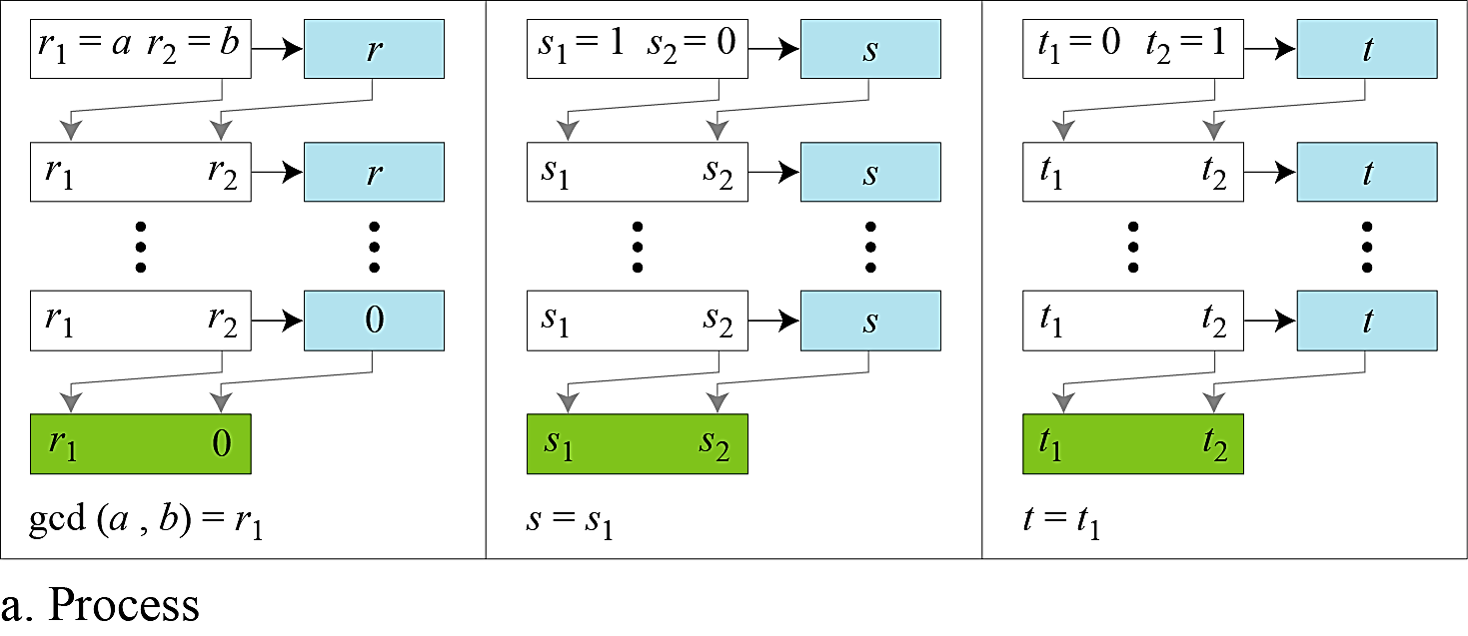
Continued
Figure a Extended Euclidean algorithm, part a

Slide 28
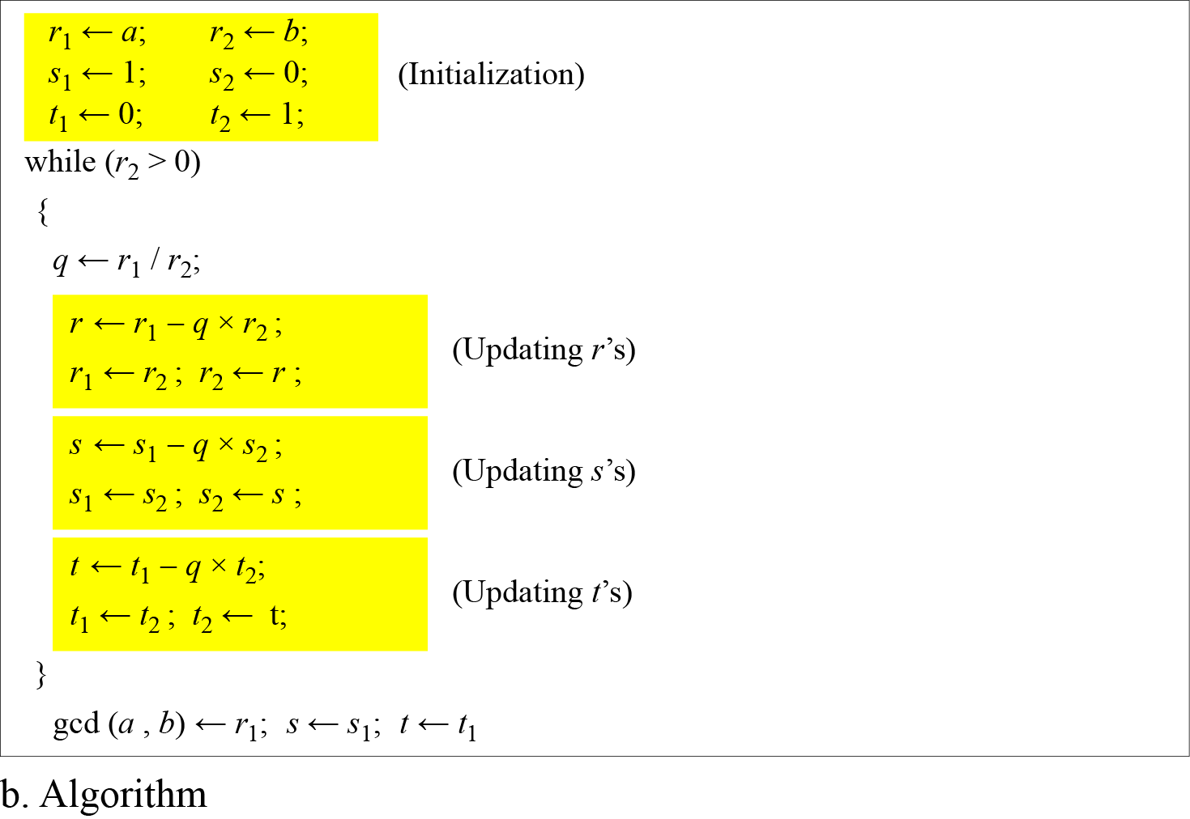
Continued
Figure b Extended Euclidean algorithm, part b

Slide 29
Continued
Example
Given a = 161 and b = 28, find gcd (a, b) and the values of s and t.
Solution
We get gcd (161, 28) = 7, s = −1 and t = 6.

Slide 30
Continued
Example
Given a = 17 and b = 0, find gcd (a, b) and the values of s and t.
Solution
We get gcd (17, 0) = 17, s = 1, and t = 0.

Slide 31
Continued
Example
Given a = 0 and b = 45, find gcd (a, b) and the values of s and t.
Solution
We get gcd (0, 45) = 45, s = 0, and t = 1.

Slide 32
Extended Euclid’s Algorithm
ExtEuclid(a, b):
if b == 0
return (a, 1, 0)
(d´, x´, y´) ← ExtEuclid(b, a mod b)
(d, x, y) ← (d´, y´, x´-floor(a/b)·y´) return (d, x, y)
d = gcd(a, b) = ax + by

Slide 33
Extended Euclid’s Algorithm
Suppose a and b are given. Find x and y such that,
ax+by=gcd (a,b)
Let, d=gcd(a,b)
Then, ax+by=d [by Thm 31.2]
Again, gcd(a,b)=gcd(b, a mod b)
So, ax+by = d = bx´+(a mod b)y´
We know that, a = b.⎣a/b⎦+a mod b
So, a mod b = a – b.⎣a/b⎦
Thus, ax+by = bx´+(a – b.⎣a/b⎦).y´
= ay´+b(x´- ⎣a/b⎦.y´)
Finally, x = y´
y =x´- ⎣a/b⎦.y´

Slide 34
Thanks All

